Slide 1

MINI PROJECT REPORT On GESTURE CONTROL ROBOTIC ARM FOR PICK AND PLACE Department of Robotics and Automation Engineering SEM: 6TH
SUBMITTED BY:
Jay gohil-190305123014
Ruturaj gohil-190305123015
Yash gaddamwar-190305123011
Yashodhan naik-190305123019
Mayurkumar -190305123016

Slide 2
aBSTRACT
mankind has always strived to give life like qualities to its artifacts in an attempt to find substitutes for himself to carry out his orders and also to work in a hostile environment. the popular concept of a robot is of a machine that looks and works like a human being. the industry is moving from current state of automation to robotization. the industrial robots of today may not look the least bit like a human being although all the research is directed to provide more and anthropomorphic and humanlike features and superhuman capabilities in these here how a pick and place robot can be designed for a workstation. all the various problems and obstruction for the loading process has Benn deeply analyzed and been taken into consideration while designing the pick and place robot

Slide 3
INTRODUCTION
Pick and place robot is the one which is used to pick up an object and place it in the desired location. the pick and place mechanical arm are a human controlled based system. it picks the object from source location and places at desired location.
The robotic arm kit is made of two sections. the bottom driving unit takes the robot to left, right, forward and backward motion. the top gripper unit is to pick and place ant object. the driving unit has two motors and also the gripper unit has two motors. the robot is strong enough to handle a task like drilling and bolting in mining industry, transporting etc.

Slide 4
Prototyping Requirements
The following are the hardware requirements that have been used to implement the prototype:
1. Arduino UNO and Bread Board.
2. Sg90 Micro servo motor
3. Gyroscope and Accelerometer.
4. Alkaline Batteries (1.5 v)
5. Laser Cut robot body
6. Flex sensors (to control the clamp of the robot arm).

Slide 5
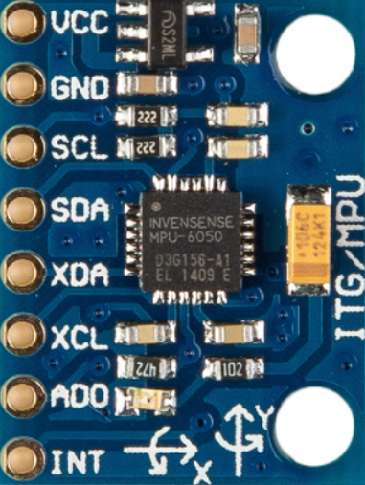
BODY OF REPORT
GYROSCOPE:
A gyroscope sensor is a device used to sense and maintain direction, designed based on the theory of indestructible angular momentum. Once the gyroscope starts to rotate, due to the angular momentum of the wheel, the gyroscope has a tendency to resist changes in direction.

Slide 6
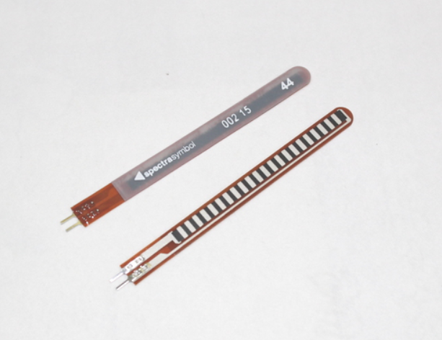
Body of report
FLEX SENSOR:
A flex sensor or bend sensor is a sensor that measures the amount of deflection or bending. Usually, the sensor is stuck to the surface, and resistance of sensor element is varied by bending the surface.

Slide 7
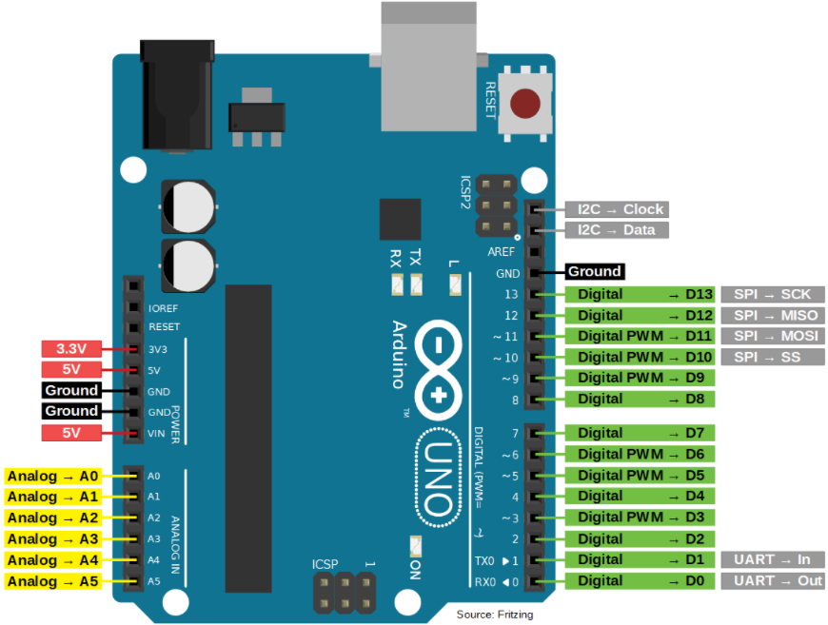
Body of report
ARDUINO UNO:
Arduino Uno is a microcontroller board based on the ATmega328P.
Operating Voltage: 5V
Input Voltage : 7-12V
Inout Voltage (limit): 6-20V
Digital I/O Pins: 14 (of which 6 provide PWM output)

Slide 8
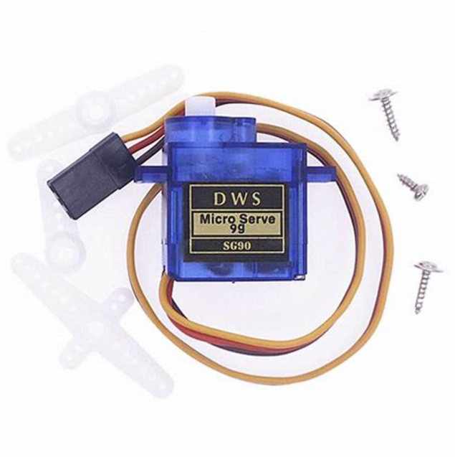
Body of report
SERVO MOTOR (Sg90):
Servo motors have a high-speed response due to low inertia and are designed with small diameter and long rotor length.
Stall Torque (4.8v): 1.3kg/cm

Slide 9
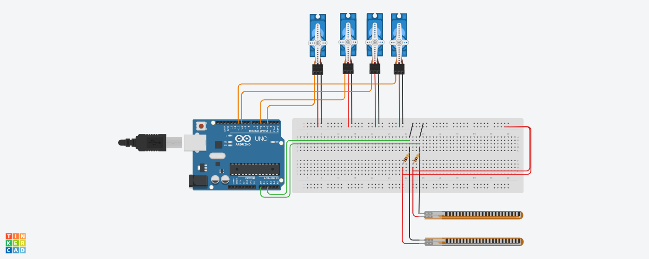
Circuit Diagram

Slide 10
CONCLUSIONS
The research objectives have been achieved which were developing both hardware and software for controlling the robotic arm based. By reviewing the observations that have been completed, it obviously shows that the movements of robotic arm are accurate, easy control, specific, and it is friendly to use by the users.
The robotic arm has been developed effectively such as the robot movements can be exactly controlled with the movements of human arm. The controlled method of the robotic arm presented in this paper is estimated to overcome many problems such as picking or placing objects that placed away from the users, pick and place dangerous objects in a very fast and easy way also, the arm presented in this paper can be used in study purpose.
FUTURE WORK..

Slide 11
REFERENCES
[1] Priyambada Mishra, Riki Patel, Trushit Upadhyaya, Arpan Desai “Review of Development Of Robotic Arm Using Arduino UNO”, International Journal on Recent Researches in Science, Engineering and Technology, ISSN: 2348-3105 Volume 5, Issue 5, May 2017.
[2] Puran Singh, Anil Kumar, Mahesh Vashishth “Design of Robotic Arm with Gripper and End effector for spot welding”, Universal Journal of Mechanical Engineering 1(3); 92-97, 2013, DOI: 10.13189/ujme,2013.010303.
[3] Areepen Sengsalonga , Nuryono Satya Widodo “ Object Moving Robot Arm based on Color”, Signal and Image Processing Letters, Vol.1., No.3, November 2019, pp. 13-19 ISSN 2714-6677.

